Slide 1
MIKE 11
1D Flood Mapping

Slide 2
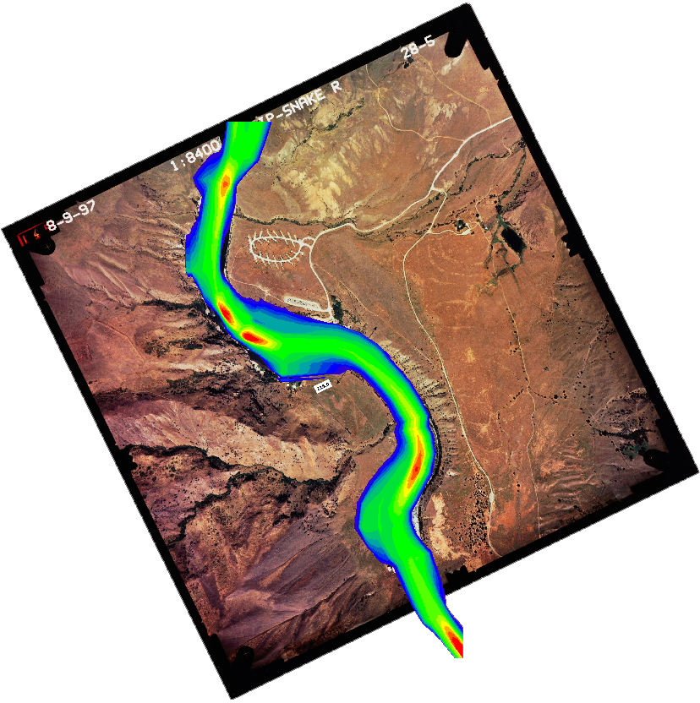
1D FLOOD MAPPING
Flood Mapping from 1D Model MIKE 11

Slide 3
1D FLOOD MAPPING
Defined in the HD Parameter File
How? HD Parameter File -> Maps Tab
Uses Linear Interpolation between Cross-Sections
Map Position, Extent and Resolution are User Defined
Static or Dynamic Data (All or Part of Simulation Length)
Different Items can be Mapped eg. Level, Depth, Invert (DEM)
Advanced Maps can be made if 2D Ground Data is Available

Slide 4
1D FLOOD MAPPING
Grid File Definition (DFS2 File Type)
K
J
DFS2 Grid File

Slide 5
1D FLOOD MAPPING
Type and Items to Map
Type:
Static (Max/Min)
Dynamic
Item:
Water level
Water depth
Velocity
Velocity * Depth
AD component
DEM
Component only used for AD

Slide 6
1D FLOOD MAPPING
Temporal Settings (Dynamic Items Only)
Multiple of the Time Step in MIKE11
Full Period of Simulation
Start and End Times for Part Simulation

Slide 7
1D FLOOD MAPPING
DEM Input Data Options
Use 2D Data to Refine Mapping

Slide 8
1D FLOOD MAPPING
DEM Output Options
DEM type can be used to make a grid of the channel geometry:
Channel only (Recommended)
Inserted directly into larger floodplain grid (improve DEM by burning river channel into the original DEM)
Best results achieved for: - small dX
- Cross-section extents defined using coordinates

Slide 9
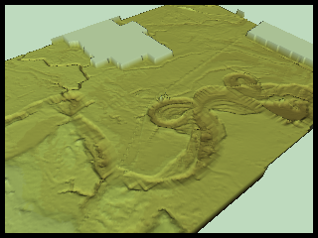
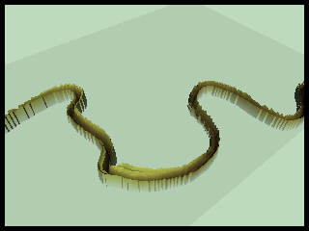
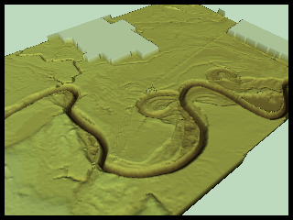
1D FLOOD MAPPING
Improving a DEM
Detailed DEM without any details about river topography
DEM of river topography created using the MIKE 11 Map feature.
Same output resolution as the original DEM.
Resulting DEM with DEM generated from MIKE 11 ’burned’ into original DEM using the Grid Editor.

Slide 10
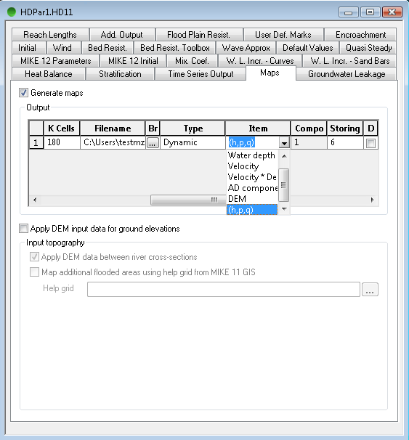
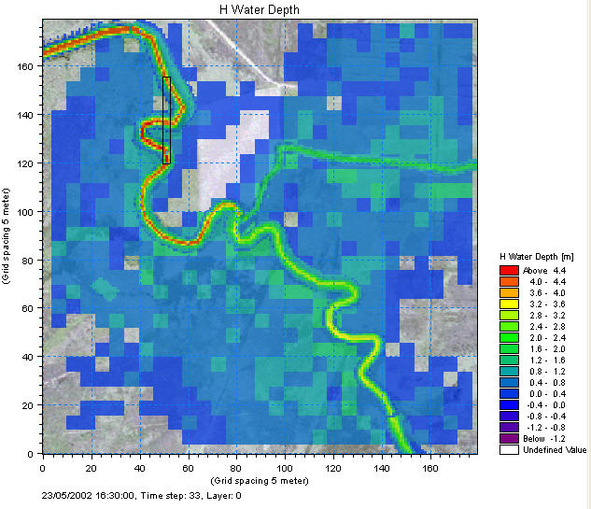
1D FLOOD MAPPING
1D-2D Seamless DFS2 Result File
Possibility to generate a result file that combines both MIKE 11 and MIKE 21 results from MIKE FLOOD simulation
HOW? Generate map in HD11 file. Item type (h,p,q)

Slide 11
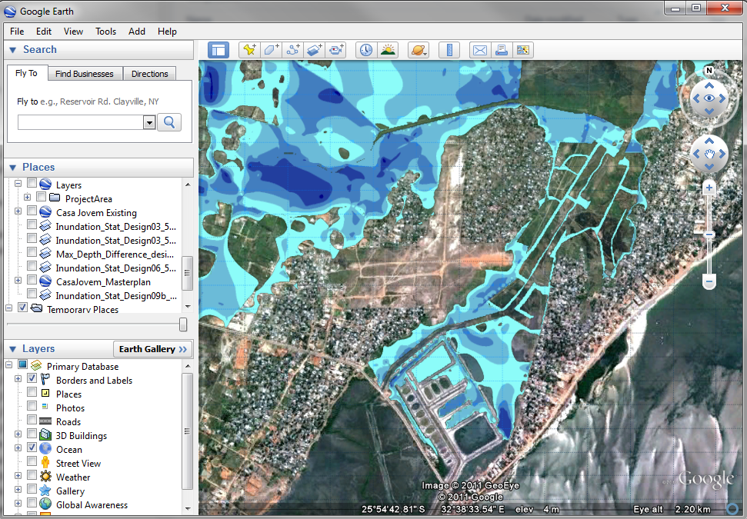
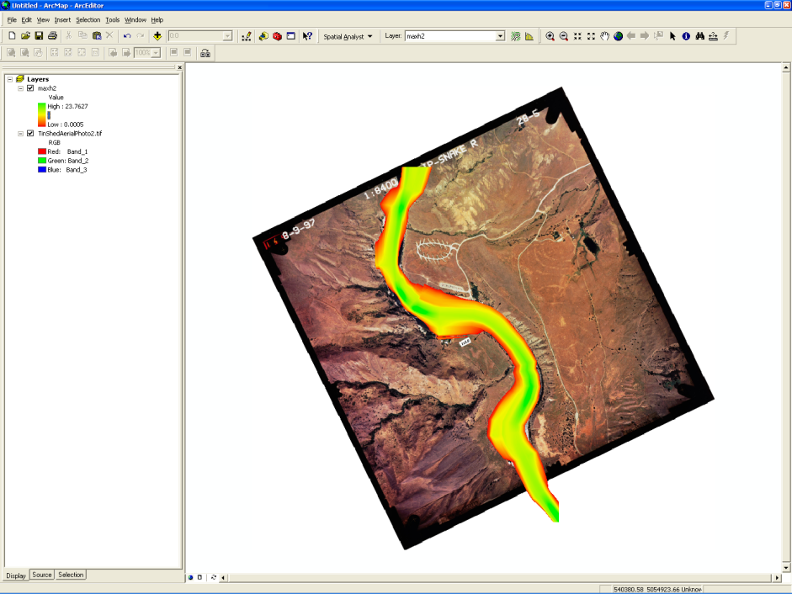
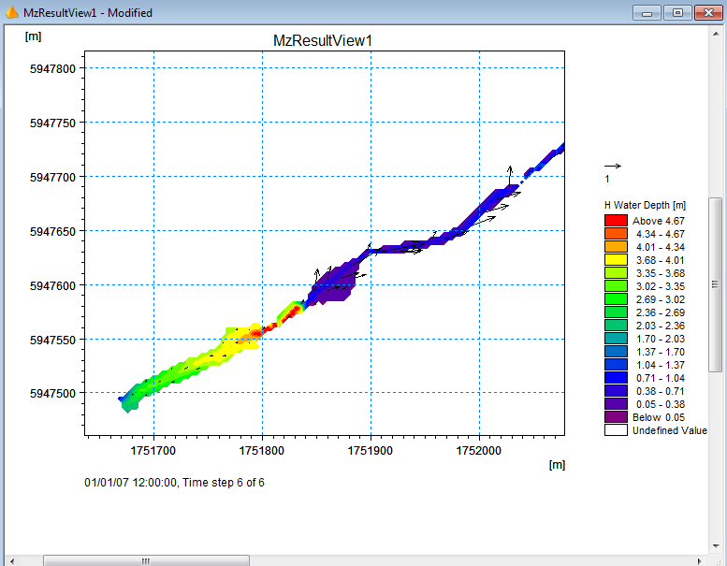
1D FLOOD MAPPING
Google Earth
Visualising Mapping Results
ArcGIS
Also:
Plot Composer
MIKE Animator Plus
Grid Editor
Result Viewer

